Slide 1
Car Selection Recommendation System
Lin Huangjing (1155072677)
ENGG5189 Fuzzy Expert System Project Presentation

Slide 2
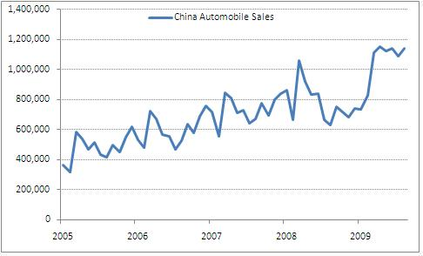
Background
Auto market is very huge in China and keep in a stable increment.
However, car selection and marketing investigation are very time consuming task.

Slide 3
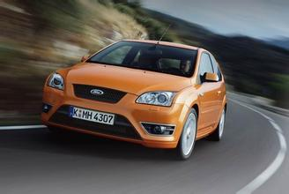

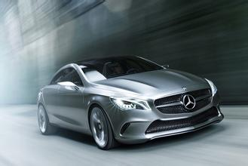
Background
When facing car selections, customers may be at loss.
Too many models, too many choices.
No idea about parameters of cars.

Slide 4
Background
What the HORSEPOWER?
What? DISPLACEMENT?
How fast the TOPSPEED is fast?
Acceleration? What figure represents high?
And so on…

Slide 5
Background
Many factors would be faced when a person select a car
Price
Seat number
Usage
Power
Inner Decoration
......

Slide 6
Background
So a well-designed car selection recommendation system is very useful for customer to make their decision.
The Theory of fuzzy query is a good solution to customers’ uncertain demands.

Slide 7
Motivation
Simplify the procedure of car selection
Help people who have no clear parameter idea also can select satisfactory cars easily
Building a system based on the theory of fuzzy query

Slide 8
Problem Definition
To solve the uncertain problems above, using a fuzzy expert system is a good choice.
In this project, I define a 3-layer inference structure to implement this project.

Slide 9
Price
Structure of Car Selection Recommendation System
seat_number
purpose
Release_date
XXX_
constraint
control
need_a_fridge
top_speed
performance
car_list
acceleration
displacement
Sound_equip
comfortable
seat_quality

Slide 10
Performance Inference
top_speed | acceleration | displacement |  | performace | Factor
H | H | H |  | H | 1.0
H | H | M |  | H | 0.9
H | M | H |  | H | 0.85
M | H | H |  | H | 0.85
H | M | M |  | H | 0.7
M | H | M |  | H | 0.7
M | M | H |  | M | 0.8
M | M | M |  | M | 1.0
M | M | L |  | M | 0.8
M | L | M |  | M | 0.6
L | M | M |  | M | 0.6
M | L | L |  | L | 0.7
L | M | L |  | L | 0.7
L | L | M |  | L | 0.85
L | L | L |  | L | 1.0
Table 1. The inference of performance (H is high; M is medium; L is low)

Slide 11
Comfortable Inference
sound_equipment | Seat_quality |  | comfortable | Factor
H | H |  | H | 1.0
M | H |  | H | 0.8
H | M |  | M | 0.8
M | M |  | M | 1.0
L | M |  | M | 0.7
M | L |  | L | 0.75
L | L |  | L | 1.0
Table 2. The inference of comfortable (H is high; M is medium; L is low)

Slide 12
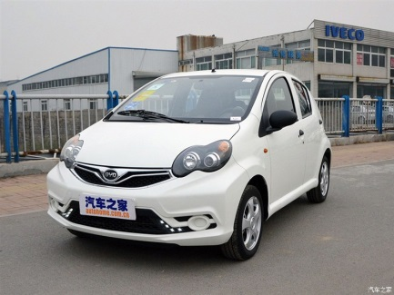

XXX_constraint Inference
The XXX_constraint is inferred from part of internal terms and input parameters, which depends on needs. If the internal terms or the input parameters do not match the features of the car greatly, the corresponding XXX_constraint of this car will be set as “no” (vice versa).
I want a high performance car
BYD-F0_constraint = “no”
BYD-F0: Low performance car

Slide 13
Car_list Inference
The car_list will be inferred from XXX_constraint, performance and comfortable.
XXX_constraint
Judge
N
Factor = 0.05
Y
Performance
Factor = ?
Comfortable

Slide 14
Knowledge Acquisition
The different car information is collected by myself from a well-known auto website named ”Autohome”.
19 sets of car information
Diversity from economical to luxury style.
Diversity in different usages such as business, home usage, race, SUV….

Slide 15
Knowledge Acquisition
Type | Price | T-speed | Acc | Displace | Conrol | seat_N | Year | frige | sound_eq | Seat_Q
VW-UP | 11.69 | 171 | 13.9 | 1.0 | A | 5 | 2015 | N | L | L
HONDA-CIVIC | 15.78 | 198 | 13.9 | 1.8 | A | 5 | 2016 | N | L | M
PEUGEOT-408 | 12.97 | 197 | 13.9 | 1.8 | M | 5 | 2014 | N | L | M
VW-Lavida | 12.39 | 188 | 11.3 | 1.6 | A | 5 | 2015 | N | M | L
TOYOTA-CAROLLA | 12.48 | 198 | 11.3 | 1.6 | M | 5 | 2016 | N | M | L
AUDI-A4L | 33.29 | 250 | 6.6 | 2.0 | A | 5 | 2016 | N | M | H
BMW-220i | 31.90 | 226 | 7.6 | 2.0 | M | 2 | 2015 | N | H | M
BENZ-C200 | 26.28 | 230 | 9.3 | 2.0 | M | 5 | 2015 | N | M | M
BUICK-Lacrosse | 22.58 | 235 | 7.4 | 2.0 | A | 5 | 2016 | N | M | H
VW-Tiguan | 30.28 | 197 | 9.9 | 2.0 | A | 5 | 2015 | N | M | M
HONDA-CRV | 17.98 | 198 | 13.9 | 2.0 | A | 5 | 2015 | N | L | M
FORT-Transit | 15.34 | 120 | 13.9 | 2.8 | M | 12 | 2015 | N | L | L
ASTON-Rapide | 428.0 | 306 | 4.9 | 6.0 | M | 4 | 2014 | N | H | H
BENZ-S500 | 199.8 | 250 | 4.9 | 4.0 | A | 5 | 2016 | Y | H | H
BENTLEY-Mulsanne | 525.8 | 296 | 5.3 | 6.8 | A | 5 | 2011 | Y | H | H
RR-Phantom | 798.8 | 250 | 7.4 | 6.7 | A | 5 | 2013 | Y | H | H
PORSCHE-Cayenne | 279.8 | 284 | 4.1 | 4.8 | M | 5 | 2015 | Y | H | H
FORT-E350 | 210.0 | 250 | 6.6 | 5.4 | A | 7 | 2011 | Y | H | H
GEELY-Supra | 9.84 | 195 | 7.6 | 1.5 | M | 2 | 2006 | N | M | L
Table 3. Knowledge Data Collecting Online

Slide 16
Project Statistics
Number of Objects
Input : 11
Output : 12
Number of Fuzzy types
8
Level of Inference
3
Number of Rule Sets
199
Average 10.47 rules per Output Object

Slide 17
Fuzzy Types
8 fuzzy sets are definded.
They are listed as follow:
Seat_number
Top_speed
Acceleration
Displacement
Sound_equipment
Seat_quality
Performance
comfortable

Slide 18
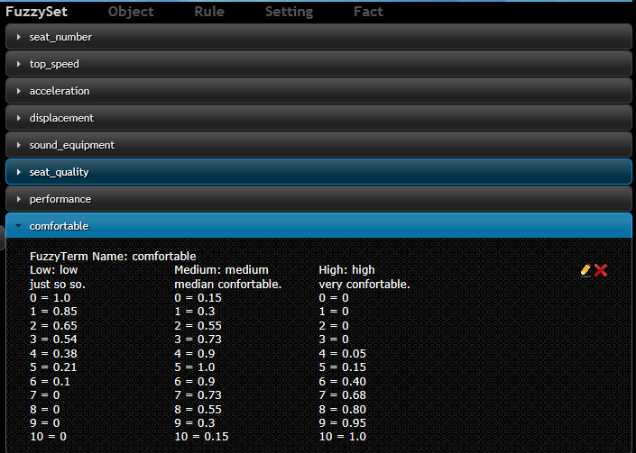
Fuzzy Types

Slide 19
Fuzzy Types
They are listed as follow:
Seat_number
about_2, about_5 and above_6
Top_speed, acceleration, displacement
Low, medium, and high
Sound_equipment, seat_quality
Low, medium, and high
Performance, comfortable
Low, medium, and high

Slide 20
Objects
33 objects in total.
11 inputs objects
22 outputs objects

Slide 21
Objects
11 inputs objects.
Price, seat_number, purpose, top_speed, acceleration, displacement, control, need_a_fridge, sound_equipment, seat_quality, release_date

Slide 22
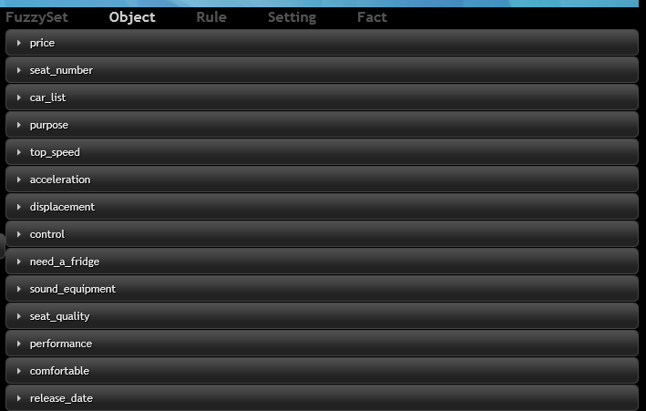
Objects

Slide 23
Objects
11 inputs objects.
Numeric :
Price (range from 10W-1000W)
Fuzzy:
Seat_number
Top_speed
Acceleration
Displacement
Sound_equipment
Seat_quality

Slide 24
Objects
11 inputs objects.
Single :
Purpose (Business, Race, SUV or Home)
Control (Manual ,Automatic or Arbitary)
Need_a_fridge (Yes, No or Arbitary)
Release_date (early, near or latest)

Slide 25
Objects
22 outputs objects.
Yes-no:
19 different car constraint (XXX_constraint)
Multiple:
Car_list (information of 19 cars)
Fuzzy
Performance
comfortable

Slide 26
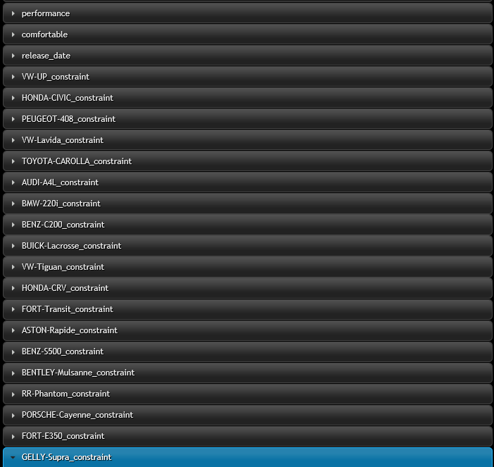

Slide 27
Rules
199 rules in total.
15 of them are used for defining Performance
7 of them are used for defining comfortable
56 of them are used for inferring constraints of different cars
121 of them are used for inferring the final results

Slide 28
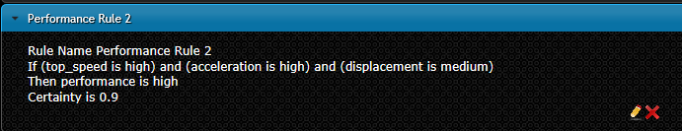
Rules
Performance Rules (15 rules)
Performance Rule 1
Performance Rule 2
…….
Performance Rule 15

Slide 29
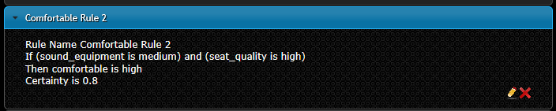
Rules
Comfortable Rules (7 rules)
Comfortable Rule 1
Comfortable Rule 2
…….
Comfortable Rule 7

Slide 30
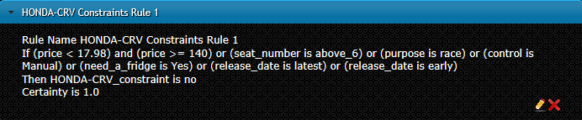
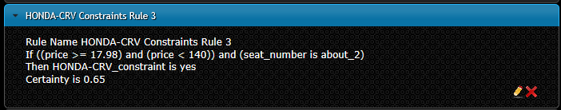
Rules
Constraint Rules (56 rules)
VW-UP constraints Rule 1
VW-UP constraints Rule 2
…….
GELLY-Supra constraints Rule 2

Slide 31
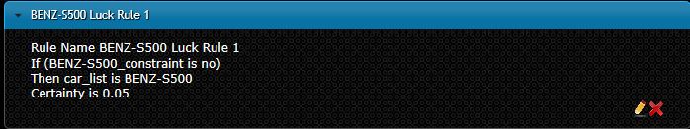
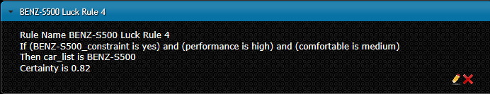
Rules
Luck Rules (121 rules)
VW-UP Luck Rule 1
VW-UP Luck Rule 2
…….
GELLY-Supra Luck Rule 2

Slide 32
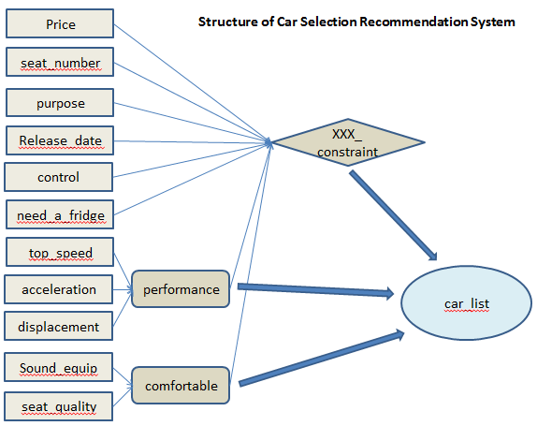
Inference Structure

Slide 33
Demonstration
Sample 1
Input:
Budget = 25(W) → seat_number = about 5 → usage (purpose = home) → top_speed = medium → acceleration = medium → displacement = low → control type = Automatic → need_a_fridge = No → quality of sound_equipment = medium → seat_quality = high → release date = latest
Notes:
Consult your own expert system

Slide 34
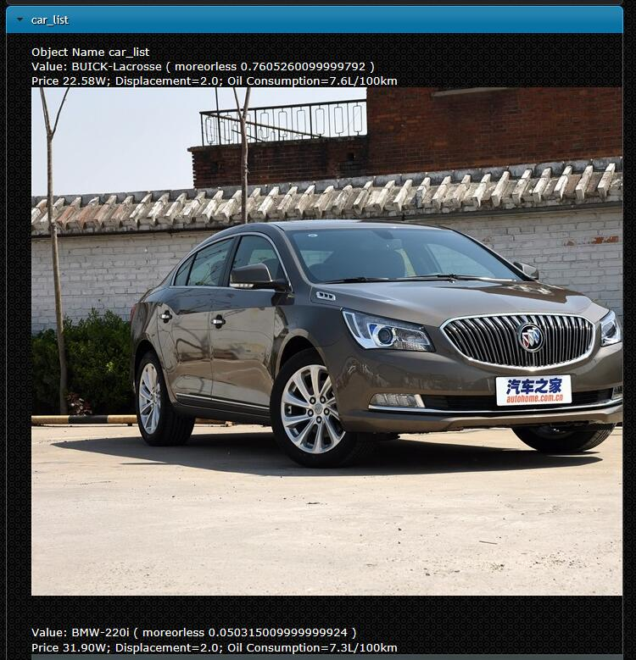
Demonstration
Sample 1
Result: (1 result recommended)
Notes:
Consult your own expert system

Slide 35
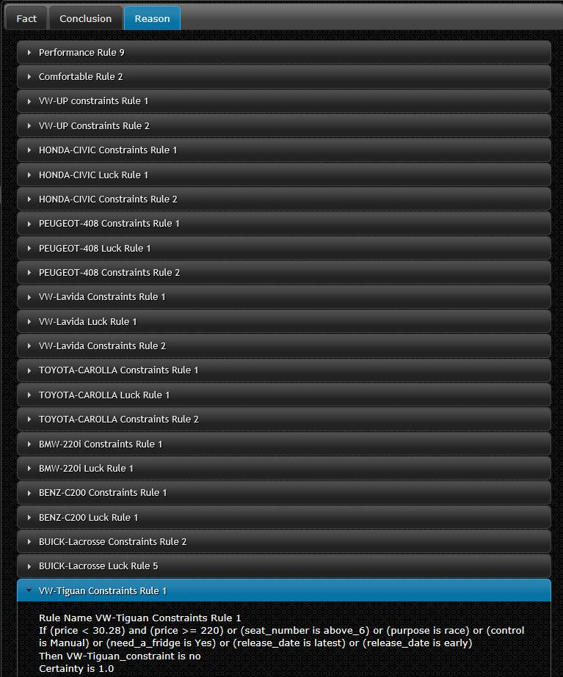
Demonstration
Sample 1
Reason:
Notes:
Consult your own expert system

Slide 36
Demonstration
Sample 2
Input:
Budget = 800(W) → seat_number = about 5 → usage (purpose = arbitary) → top_speed = high → acceleration = high → displacement = high → control type = arbitary → need_a_fridge = arbitary → quality of sound_equipment = high → seat_quality = high → release date = arbitary
Notes:
Consult your own expert system

Slide 37
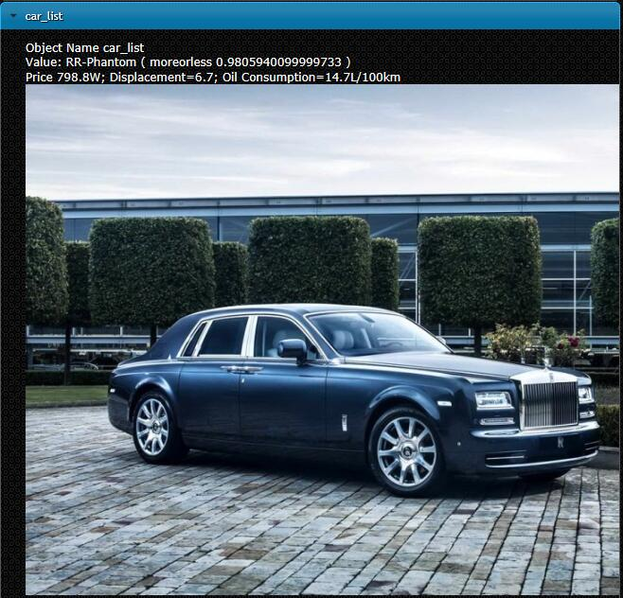
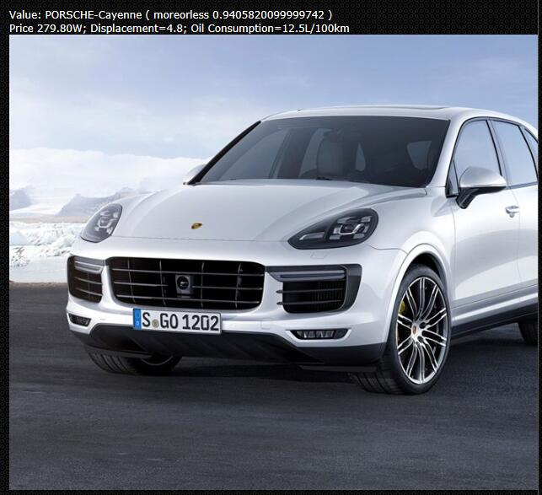
Demonstration
Sample 2
Result: (5 results recommended)
Notes:
Consult your own expert system

Slide 38
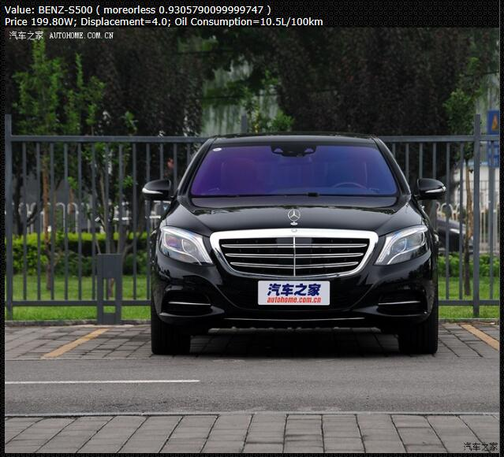
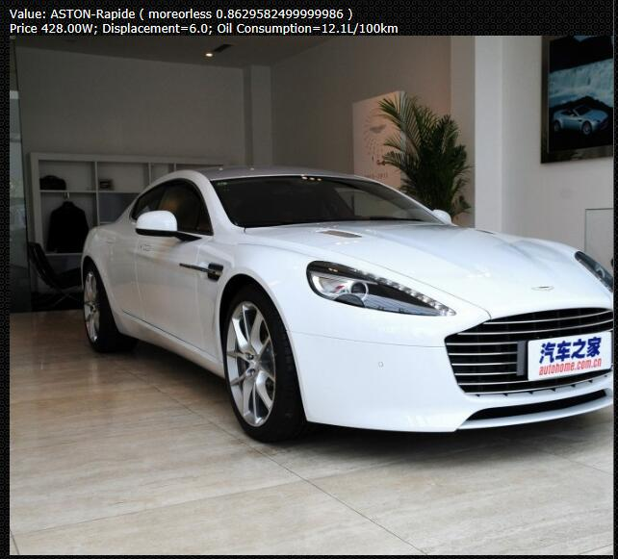
Demonstration
Sample 2
Result: (5 results recommended)
Notes:
Consult your own expert system

Slide 39
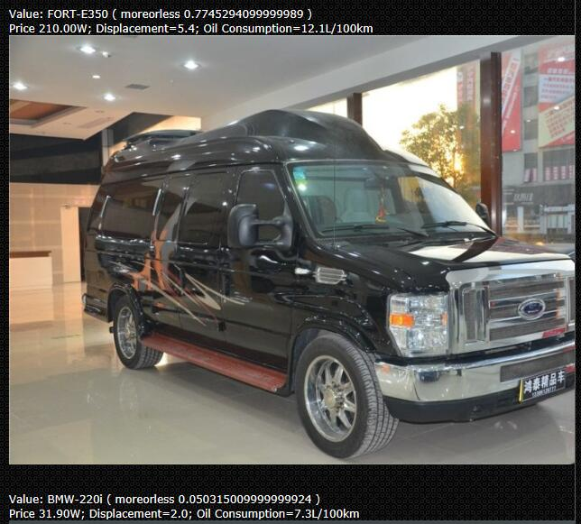
Demonstration
Sample 2
Result: (5 results recommended)
Notes:
Consult your own expert system

Slide 40
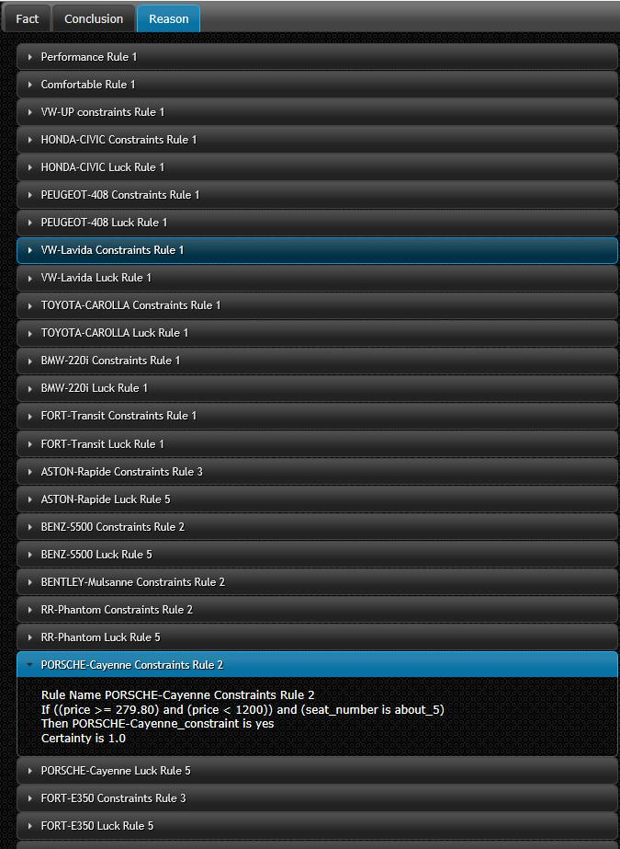
Demonstration
Sample 2
Reason:
Notes:
Consult your own expert system

Slide 41
References
[1] Leung, Kwong-Sak, and W. Lam. "Fuzzy concepts in expert systems."Computer 21.9 (1988): 43-56.
[2] Website Autohome—“www.autohome.com.cn”

Slide 42
Thank you!

